Slide 1
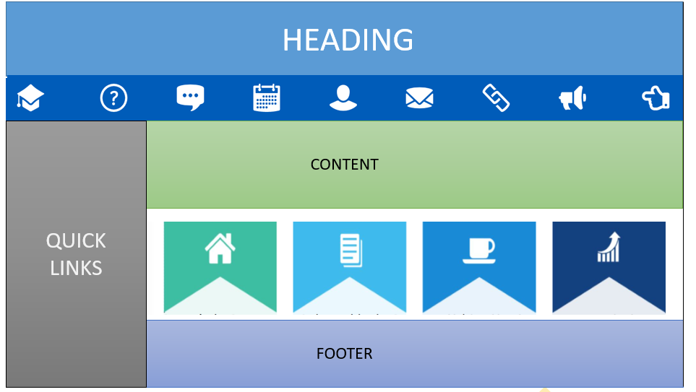
MY SAMPE WEB PORTAL LAYOUT
Functionality keys
( SUPPORT, FAQ, YAMMER, RELATED LINKS, FEEDBACK )
Links to other services
OBJECTIVES, EXPECTATION ACTIVITY, OUTCOME
( In form of vertical drop down )

Slide 2
LINKS
1.LINKS TO TAKE PORTAL REFERENCE
PowerMax (ge.com) [ I found this design most suitable to start off with]
Gas Power Data Portal (ge.com)
Product Excellence Methodology (PEM) (pka Lean Product Execution Framework) - Gas Power IT LEAN Framework - Developer Cloud (ge.com)
2.ONSHORE WIND DESIGN DOC
OneWIND Design Guide.pptx | Powered by Box
3.DESIGN LINKS
MAIN LINK→
UX/UI Design Guide - ONEWIND - Developer Cloud (ge.com)
GMD Framework Extensions - ONEWIND - Developer Cloud (ge.com)
Components - Material Design
Material Components Web | Catalog (material-components.github.io)
ICONS
Free Icons | Font Awesome
Icons - Material Design
4.LEARNING MAT(FOR MY REFERENCE)
1. Material-UI: A popular React UI framework (material-ui.com)
2. Angular Material UI component library

Slide 3
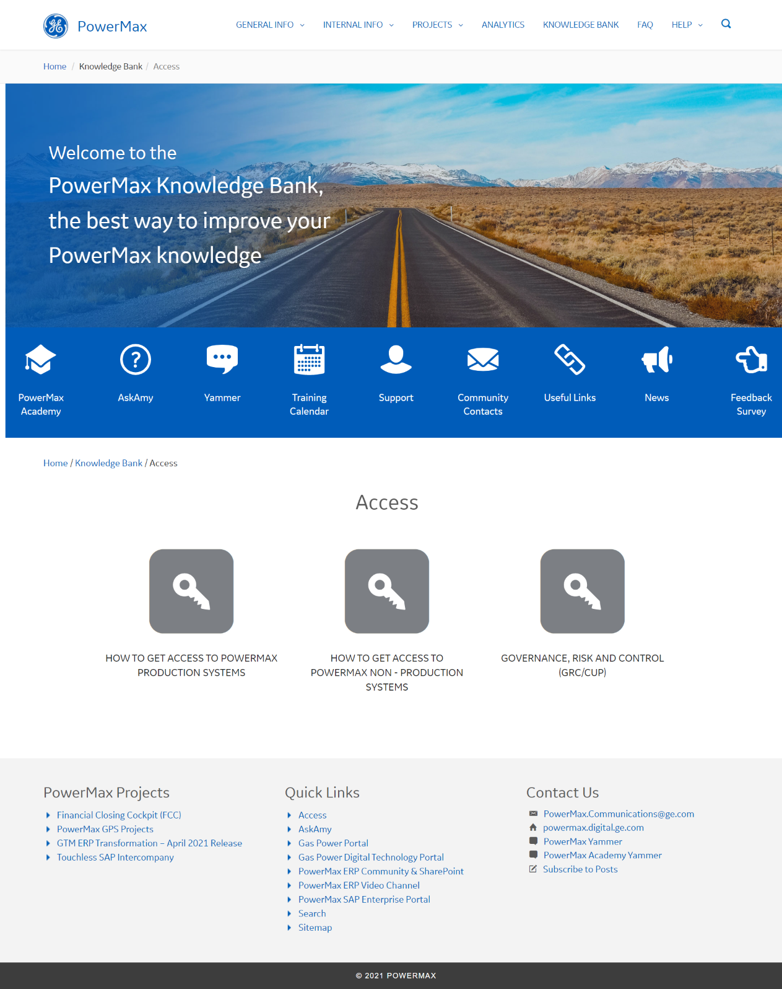
Web portal ref 1
HEADER
Functionality keys
(support, related links, FAQ)
CONTENT
FOOTER
**As a user I felt it will be more reliable if the Quick links are on the left vertically
I found this layout suitable to start off with.
PowerMax (ge.com)

Slide 4
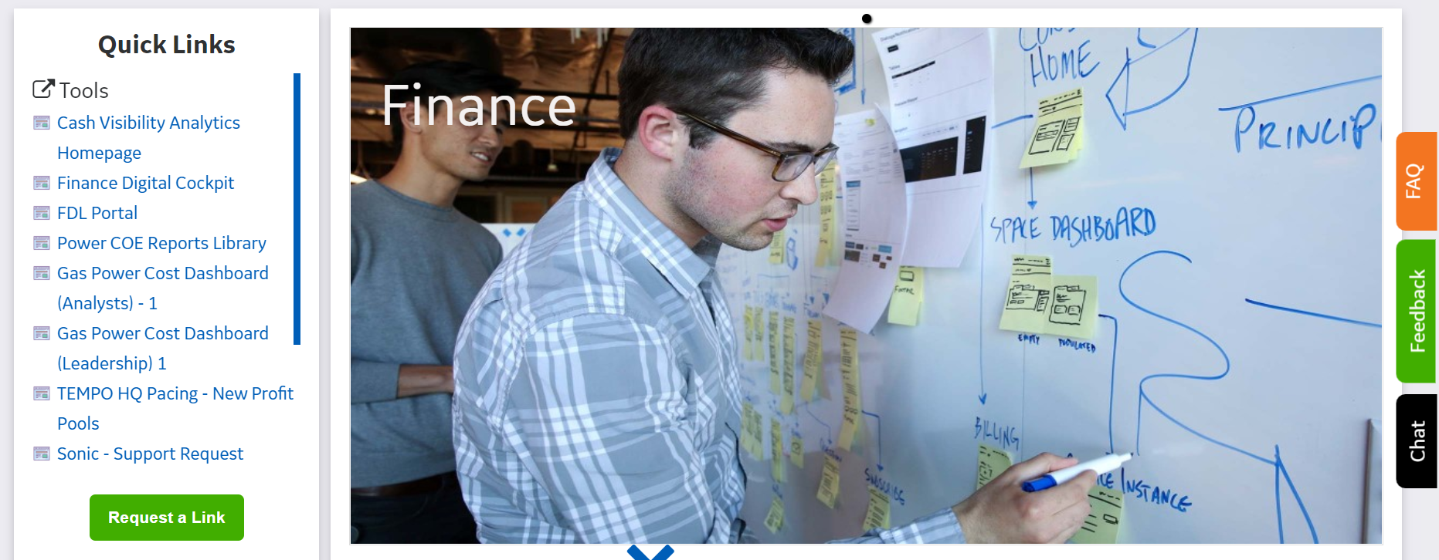
Web portal ref 2
Quick Link
**As a new user navigating through Quick link was easier for me when it is in left as in here
Reference for Quick Link.
PowerMax (ge.com)

Slide 5
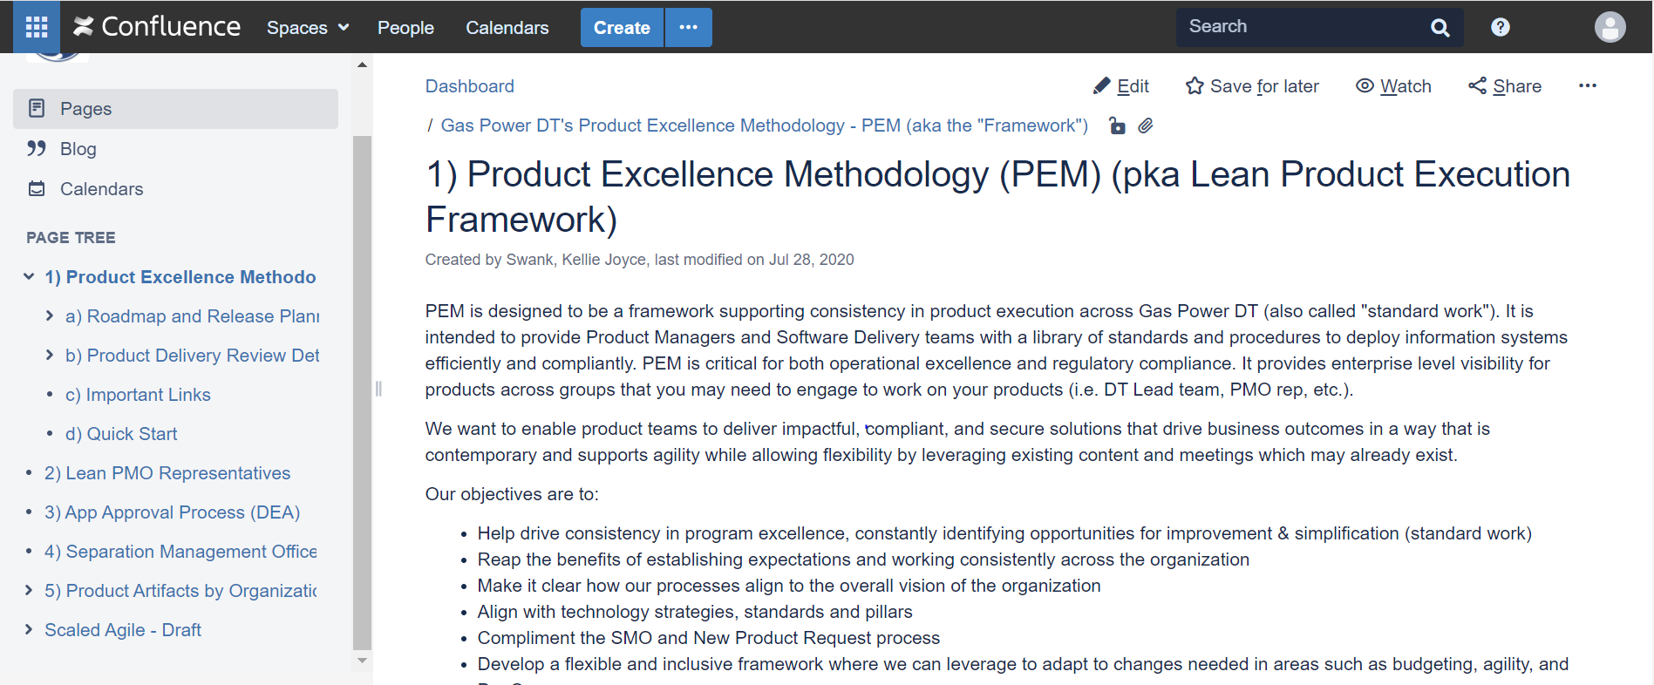
Web portal ref 3
Quick Link
**As a new user navigating through Quick link was easier for me when it is in left as in here
Reference for Quick Link.
Product Excellence Methodology (PEM) (pka Lean Product Execution Framework) - Gas Power IT LEAN Framework - Developer Cloud (ge.com)

Slide 6
UI/UX Design Guide for REN DT
UI/UX Design Guide link
Very useful
UX/UI Design Guide - ONEWIND - Developer Cloud (ge.com)
PPT for Design Guide
Double click on doc to open full PPT
Link for Design guide PPT.
OneWIND Design Guide.pptx | Powered by Box

